Slide 1
9 Tips to Protect Yourself from Phishing Scam Emails
Stay Safe Online
By Jonathan Tanuwijaya
ID 18399

Slide 2
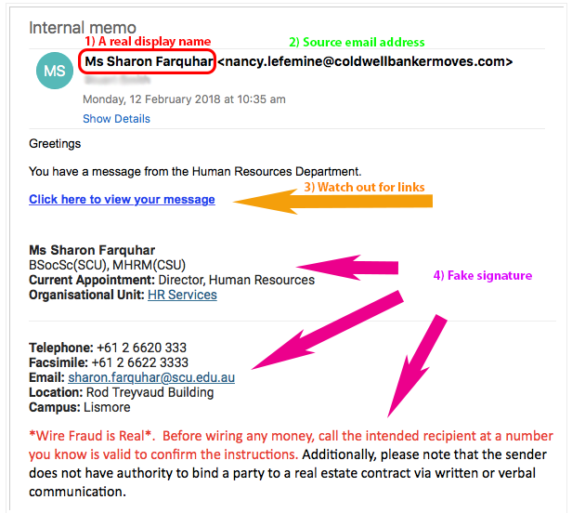
1st tip: "Verify the sender's email address"
Check the sender's email address carefully for any suspicious or unfamiliar domains.

Slide 3
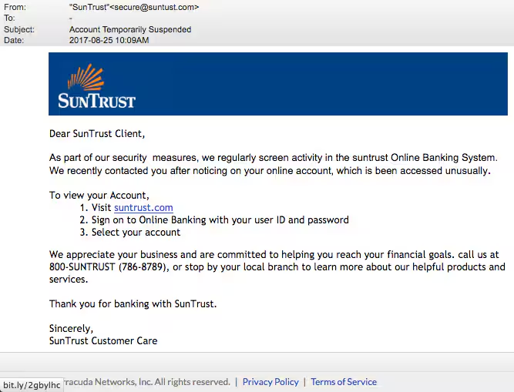
2nd tip: "Beware of urgent requests"
Be cautious of emails urging immediate action or threatening consequences if you don't comply. Take time to verify the authenticity of such requests.

Slide 4
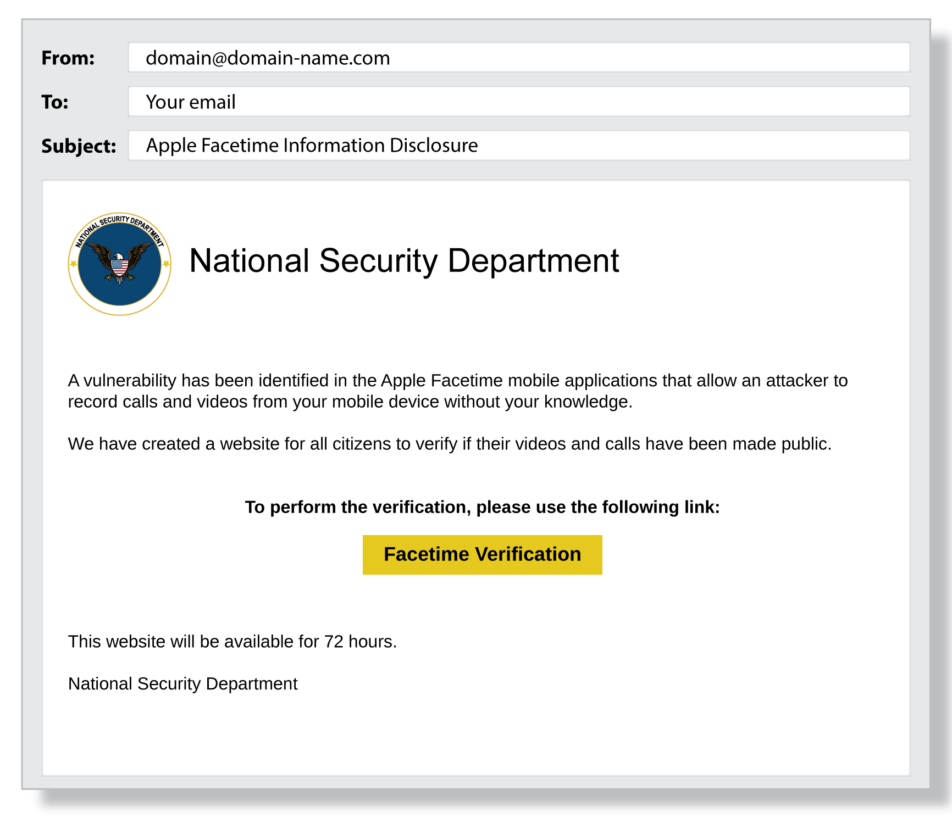
3rd tip: "Avoid clicking on links"
Refrain from clicking on links or downloading attachments from unfamiliar or unexpected emails, as they may lead to malicious websites or malware.

Slide 5
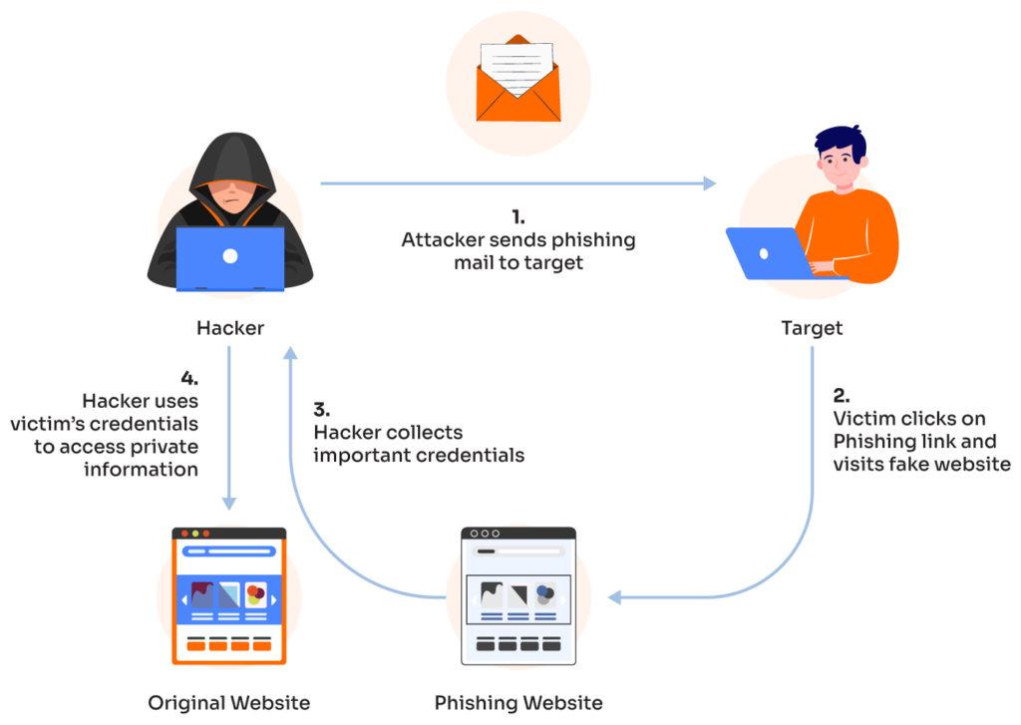
4th tip: "Verify requests for sensitive information"
Legitimate organizations will never ask for sensitive information such as passwords, account numbers, or Social Security numbers via email. Be skeptical of any requests for such details.

Slide 6
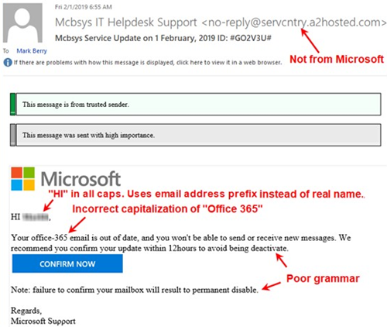
5th tip: "Look for spelling and grammar errors"
Phishing emails often contain spelling and grammar mistakes. Pay attention to these details as they may indicate a fraudulent email.

Slide 7
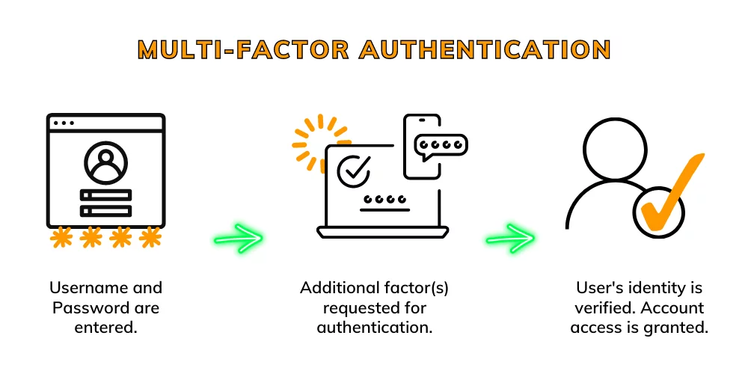
6th tip: "Enable multi-factor authentication"
Utilize multi-factor authentication whenever possible to add an extra layer of security to your accounts.

Slide 8

7th tip: "Use security software"
Install and regularly update reputable antivirus and antimalware software to detect and prevent phishing attempts.

Slide 9
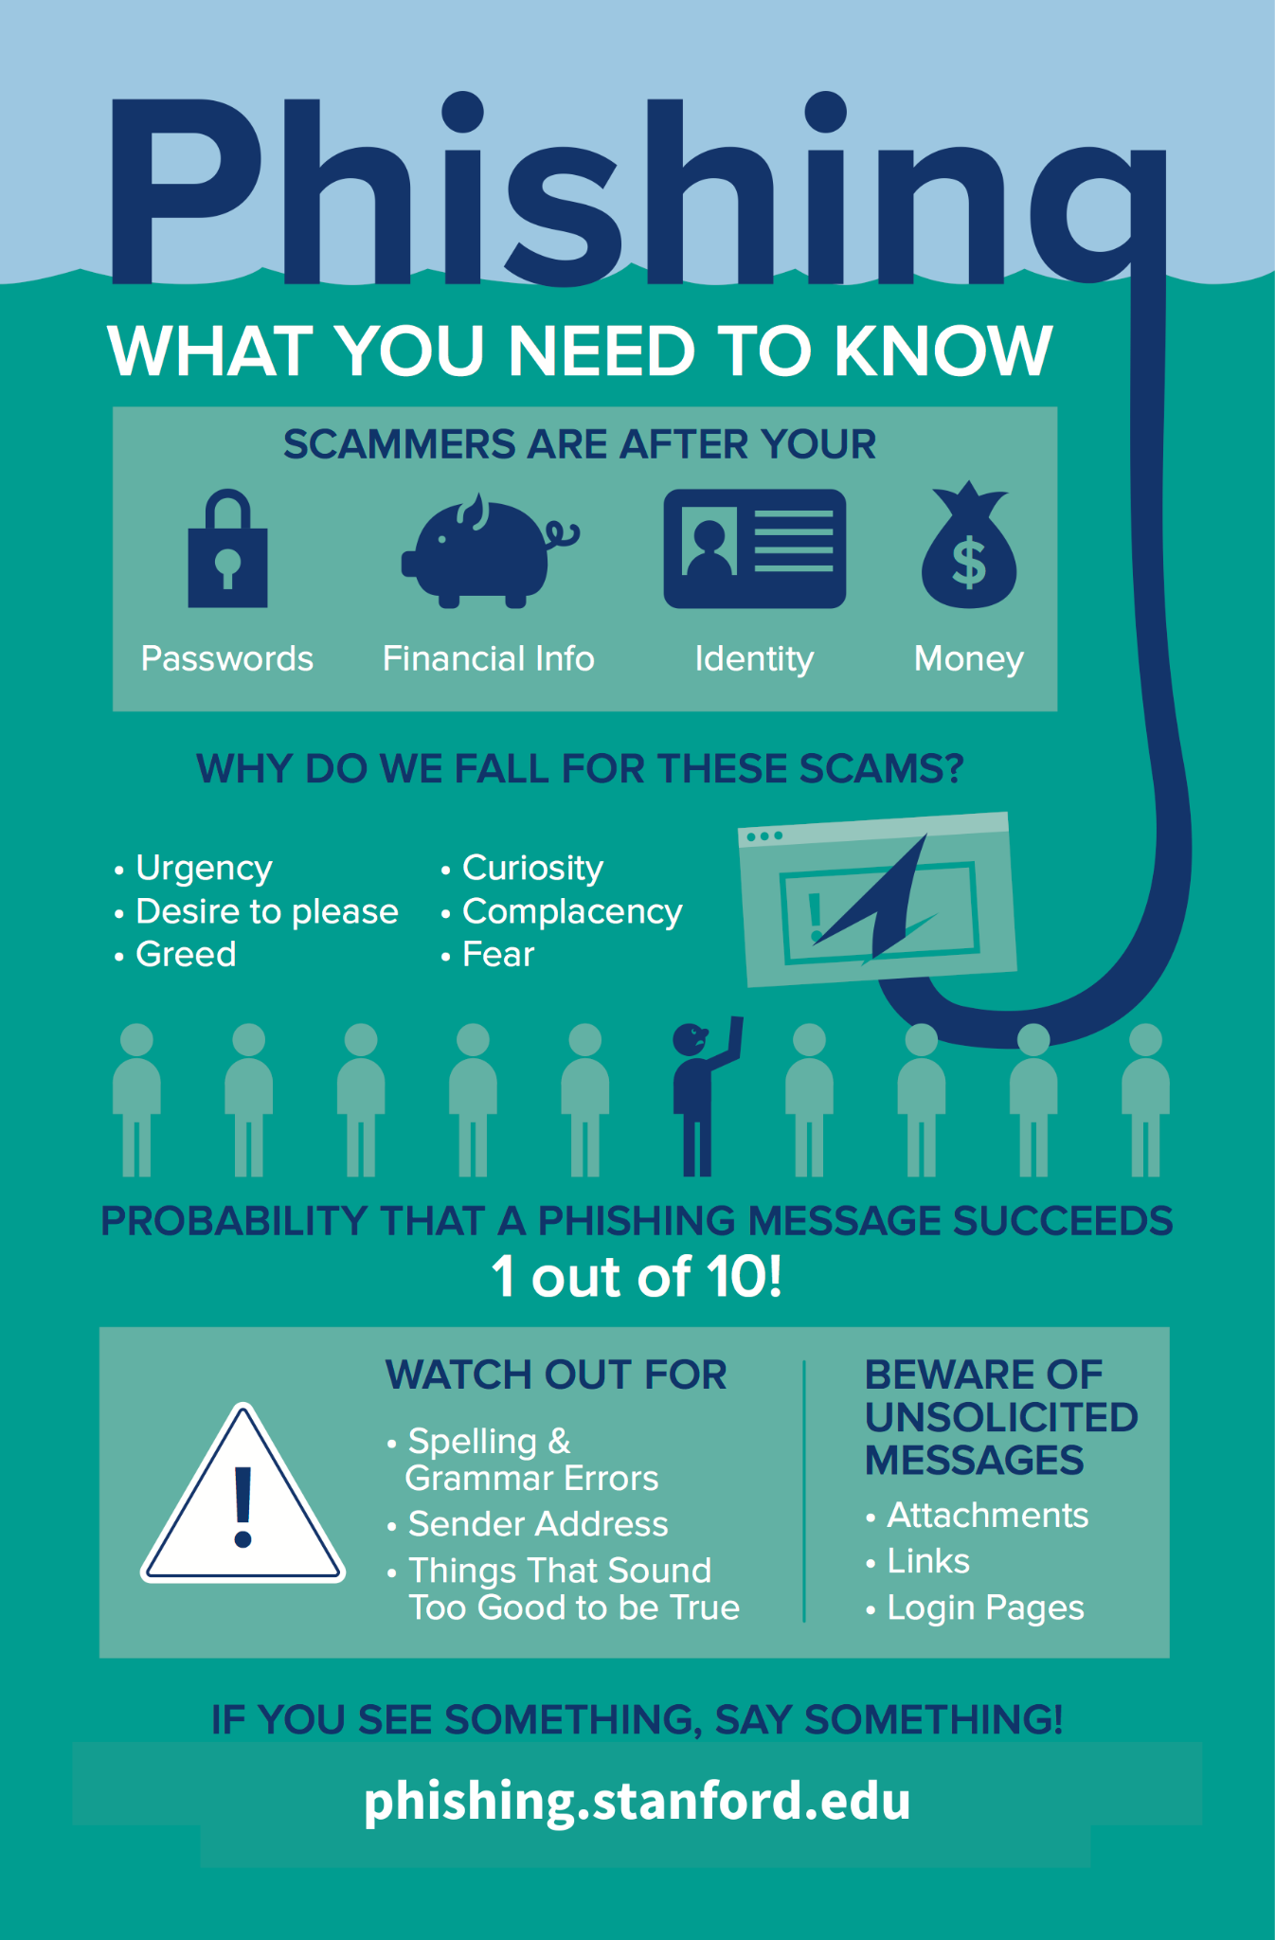
8th tip: "Educate yourself"
Stay informed about common phishing tactics and regularly educate yourself and your colleagues about how to recognize and avoid them.

Slide 10
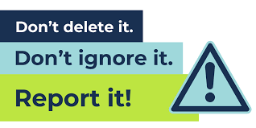
9th tip: "Report suspicious emails"
If you receive a suspicious email, report it to your organization's IT department or to the appropriate authorities to help prevent others from falling victim to phishing scams.

Slide 11

Conclusion
Following these tips, you can significantly reduce the risk of falling victim to phishing scam emails and safeguard your personal information online.Stay vigilant and implement the tips to protect against phishing scams.

